Slide 1
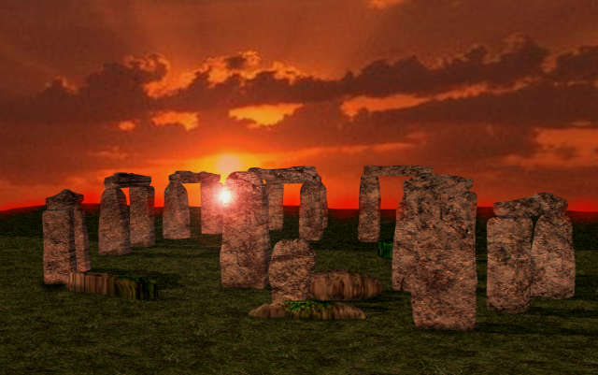
History of astronomy
How it all began.

Slide 2
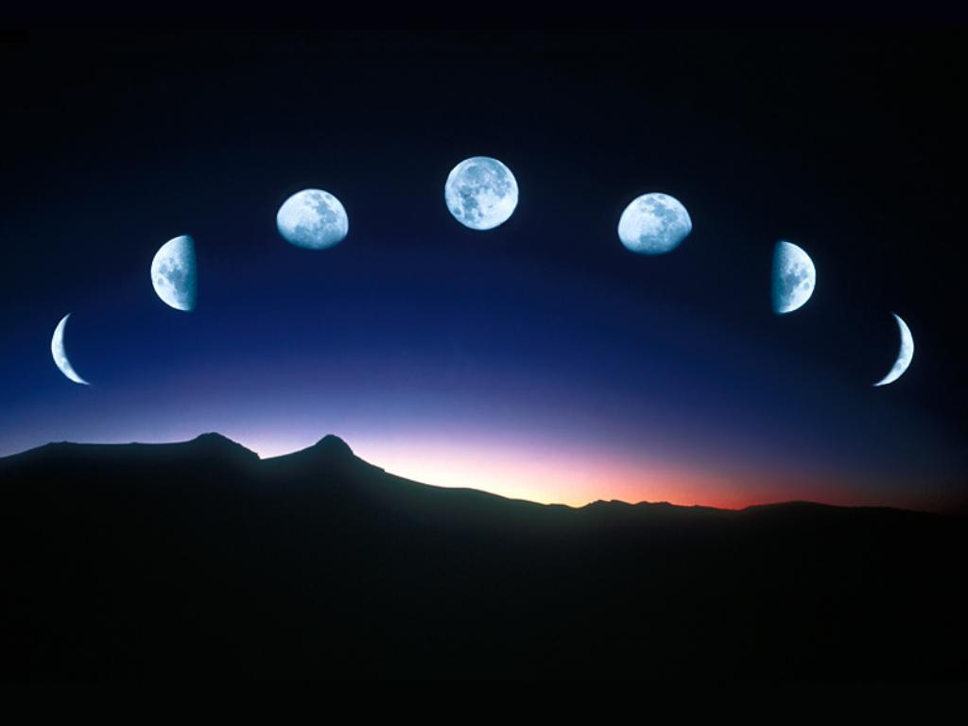
Archaeoastronomy
Astronomy began thousands of years ago!
“Cavemen” noticed moon phases, planetary motion, and relative star stability.
Early agrarian societies depended on the Sun and Moon phases.
Seasons became important.
They believed that fertility was related to lunar phases.

Slide 3
Archaeoastronomy
The day was divided by the movement of the Sun.
The 7 day week… 3 possibilities:
Babylonians - 7 observed celestial objects
Hebrews (Jews) – YHWH, no work on 7th day
Greeks - Phases of the moon
The month is based on 12 lunar cycles between one spring and the next.
The year was marked by the heliacal (dawn) rising of specific stars.
Notes:
Heliacal rising occurs when it first becomes visible above the eastern horizon for a brief moment just before sunrise, after a period of time when it had not been visible.
Each day after the heliacal rising, the star will rise slightly earlier and remain visible for longer before the light from the rising sun makes it disappear (the sun appears to drift eastward relative to the stars by about one degree a day along a path called the ecliptic). Over the following days the star will move further and further westward (about one degree per day) over the dome of the pre-dawn sky, until eventually it is no longer visible in the sky at dawn because it has already set below the western horizon. The same star will reappear in the eastern sky at dawn approximately one year after its previous heliacal rising

Slide 4
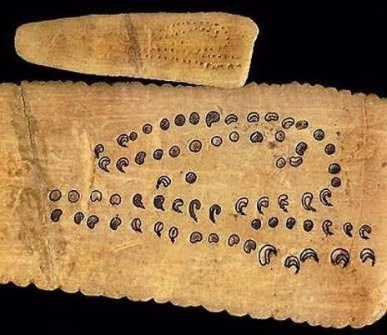
Archaeoastronomy
The oldest Lunar calendar on Earth dates back to c.32,000 B.C. from the Aurignacian Culture of Europe.
Notes:
The Oldest Lunar Calendars and Earliest Constellations have been identified in cave art found in France and Germany. The astronomer-priests of these late Upper Paleolithic Cultures understood mathematical sets, and the interplay between the moon annual cycle, ecliptic, solstice and seasonal changes on earth.
It demonstrates the intelligence of our ancestors who understood the significance of the lunar cycle and realized that this knowledge needed to be recorded as an aid for farming, hunting, reproducing and ritual. Marshack deciphered sets of marks carved into animal bones, and occasionally on the walls of caves, as records of the lunar cycle. These marks are sets of crescents or lines. Artisans carefully controlled line thickness so that a correlation with lunar phases would be as easy as possible to perceive. Sets of marks were often laid out in a serpentine pattern that suggests a snake deity or streams and rivers.

Slide 5
Callippus
C.370 – 310 B.C.
Greek philosopher who attended astronomy school
Supported geocentric model and homocentric model
Using days and rotations per orbit of the Sun, he was able to accurately measure seasons and calculated the 365.25 day year.

Slide 6
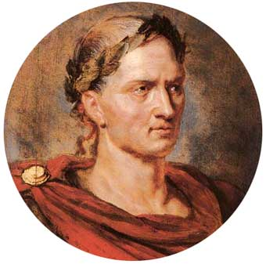
Roman Calendar
Reintroduced by Julius Caesar
Closest to the modern calendar
Gained popularity in 46 B.C. after other models were used for some time.
Months were 29 or 30 days long…
How accurate was this?
Ave. month = 29.5
12 months in 1 year
29.5*12 = 354
Plus leap month 377 days!

Slide 7
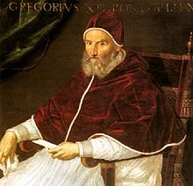
Gregorian Calendar
Accounts for that ¼ day…leap year!
Introduced by Pope Gregory XIII in 1582.
Most accurate so far.
Adopted in America in 1752… and in Greece by 1923!

Slide 8
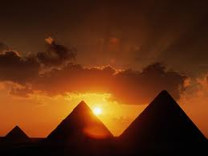
What about…
Some people couldn’t read or write
Not everyone had the same education
Different localities
But…all cultures had driving factors: food, religion, weather…

